Slide 1

Microsoft AIML
Alessandro Recino
Principal Cloud Solution Architect
Advanced Analytics & AI

Slide 2
Microsoft’s AI Principles
Fairness
Reliability
& Safety
Privacy & Security
Inclusiveness
Transparency
Accountability
Notes:
At Microsoft, as a foundation to guide our thinking, we defined 6 ethical principles that AI systems should adhere to
The first 4 (fairness, reliability&safety, privacy&security and inclusiveness) represent key properties that the system should achieve.
The second 2 (transparency and accountability) are underneath all of the other principles and guide how we design, implement and operationalize AI systems

Slide 3
Responsible AI
AI driven by ethical principles that put people first
ORA – Office of Responsible AI
AETHER - AI and Ethics in Engineering and Research

Slide 4
ORA
Governance
Teams Enablement
Sensitive use cases
Public Policies

Slide 5
AETHER
Charter
Members
Working groups

Slide 6

FAIRNESS
More positive outcomes & avoiding harmful outcomes of AI systems for groups of people

Slide 7
AI system behaving unfairly in terms of its impact on people in terms of harms, or in terms of intent, such as prejudice
Fairness of
AI systems

Slide 8
Types of harm
Allocation: extends or withholds opportunities, resources, or information.
Quality of service: whether a system works as well for one person as it does for another
Stereotyping: reinforce existing societal stereotypes
Denigration: actively derogatory or offensive
Over or under representation: over-represent, under-represent, or even erase particular groups of people
Crawford et al. 2017

Slide 9
A new approach to measuring and mitigating unfairness in systems that make predictions, serve users, or make decisions about allocating resources, opportunities, or information.
What is Fairlearn?

Slide 10

Help users identify and mitigate unfairness in their machine learning models with a focus on group fairness.
Automatically analyze a model’s predictions
Provide the user with insights into (un)fairness of their model’s predictions
Support (algorithmic) methods to mitigate unfairness
Disclaimer: Fairness is fundamentally a sociotechnical challenge. Many aspects of fairness, such as justice and due process, aren’t captured by quantitative fairness metrics. Since there are many quantitative fairness metrics, which cannot be all simultaneously satisfied, we seek to enable humans to make trade-offs depending on the context.
github.com/fairlearn/fairlearn
Notes:
There are many approaches to conceptualizing fairness. In Fairlearn, we follow the approach known as group fairness, which asks: Which groups of individuals are at risk for experiencing harms?
The relevant groups (also called subpopulations) are defined using sensitive features (or sensitive attributes), which are passed to a Fairlearn estimator as a vector or a matrix called sensitive_features (even if it is only one feature). The term suggests that the system designer should be sensitive to these features when assessing group fairness. Although these features may sometimes have privacy implications (e.g., gender or age) in other cases they may not (e.g., whether or not someone is a native speaker of a particular language). Moreover, the word sensitive does not imply that these features should not be used to make predictions – indeed, in some cases it may be better to include them.
Fairness literature also uses the term protected attribute in a similar sense as sensitive feature. The term is based on anti-discrimination laws that define specific protected classes. Since we seek to apply group fairness in a wider range of settings, we avoid this term.

Slide 11
Types of harm
Allocation: extends or withholds opportunities, resources, or information.
Quality of service: whether a system works as well for one person as it does for another
Stereotyping: reinforce existing societal stereotypes
Denigration: actively derogatory or offensive
Over or under representation: over-represent, under-represent, or even erase particular groups of people
github.com/fairlearn/fairlearn
Crawford et al. 2017
Notes:
Broadly speaking, based on the Taxonomy developed by Hanna and her collaborators at MSR there are 5 different types of harm that can occur in a machine learning system and while I have the definitions of all of them on this slide, for the scope of this project, we just focus on two of these harms.
Allocation: which is the harms that can occur when AI systems extend or withhold opportunities, resources, or information to specific groups of people.
Quality of service: whether a system works as well for one person as it does for another. The example of the face recognition from my previous slide highlights this harm.
Stereotyping: AI systems can reinforce existing societal stereotypes, sometimes in ways that can be difficult to anticipate
Denigration: Denigration occurs when an AI system is actively derogatory or offensive
Over- or under-representation: This type of harm can arise when AI systems over-represent, under-represent, or even erase particular groups of people or subpopulations.

Slide 12
Fairlearn Toolkit
Evaluation
Assessment
Select a protected attribute
Select a fairness metric (e.g., disparity in recall, precision, etc and disparity in selection rate)
Visualizations
Fairness Criteria
Mitigation
Demographic Parity
Equalized Odds
Mitigation Algorithm
Postprocessing Method
Reduction Method

Slide 13
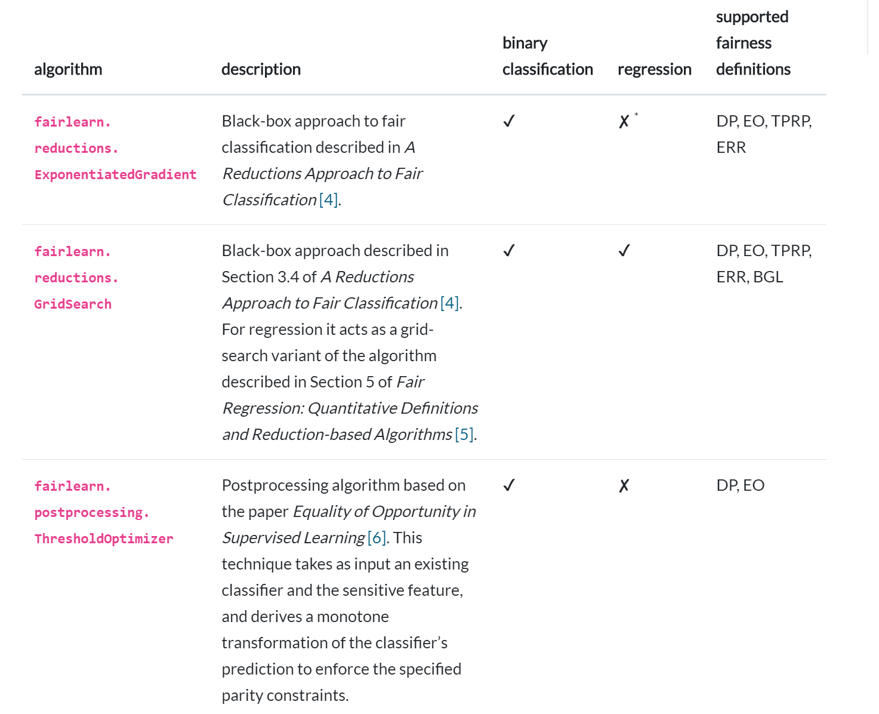
Mitigation

Slide 14
Demographic Parity
https://arxiv.org/pdf/1803.02453.pdf
A classifier h satisfies demographic parity under a distribution over (X, A, Y ) if its prediction h(X) is statistically independent of the protected attribute A
P[h(X) = ˆy | A = a] = P[h(X) = ˆy] for all a, yˆ

Slide 15
Equalized Odds
https://arxiv.org/pdf/1803.02453.pdf
A classifier h satisfies equalized odds under a distribution over (X, A, Y ) if its prediction h(X) is conditionally independent of the protected attribute A given the label
P[h(X) = ˆy | A = a, Y = y] = P[h(X) = ˆy | Y = y] for all a, y, and yˆ

Slide 16
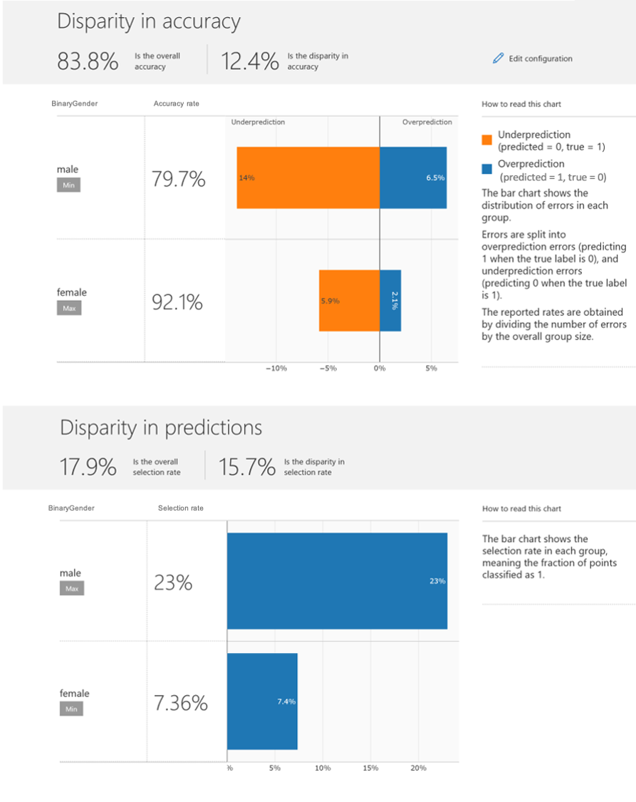
DEMO
Machine Learning
Fairness
https://github.com/interpretml/interpret-community

Slide 17
Responsible AI is an End-to-End Process
Business understanding
Deployment & Ops
Data acquisition & understanding
Modeling

Slide 18



Building Trusted Machine Learning
Platform
Build on a platform that is secure and trustworthy
Process
Focus on reliable, reproducible processes that incorporate human oversight and the state-of-art best practices
Models
Emphasize deeper understanding of model behavior, analysis, and testing

Slide 19
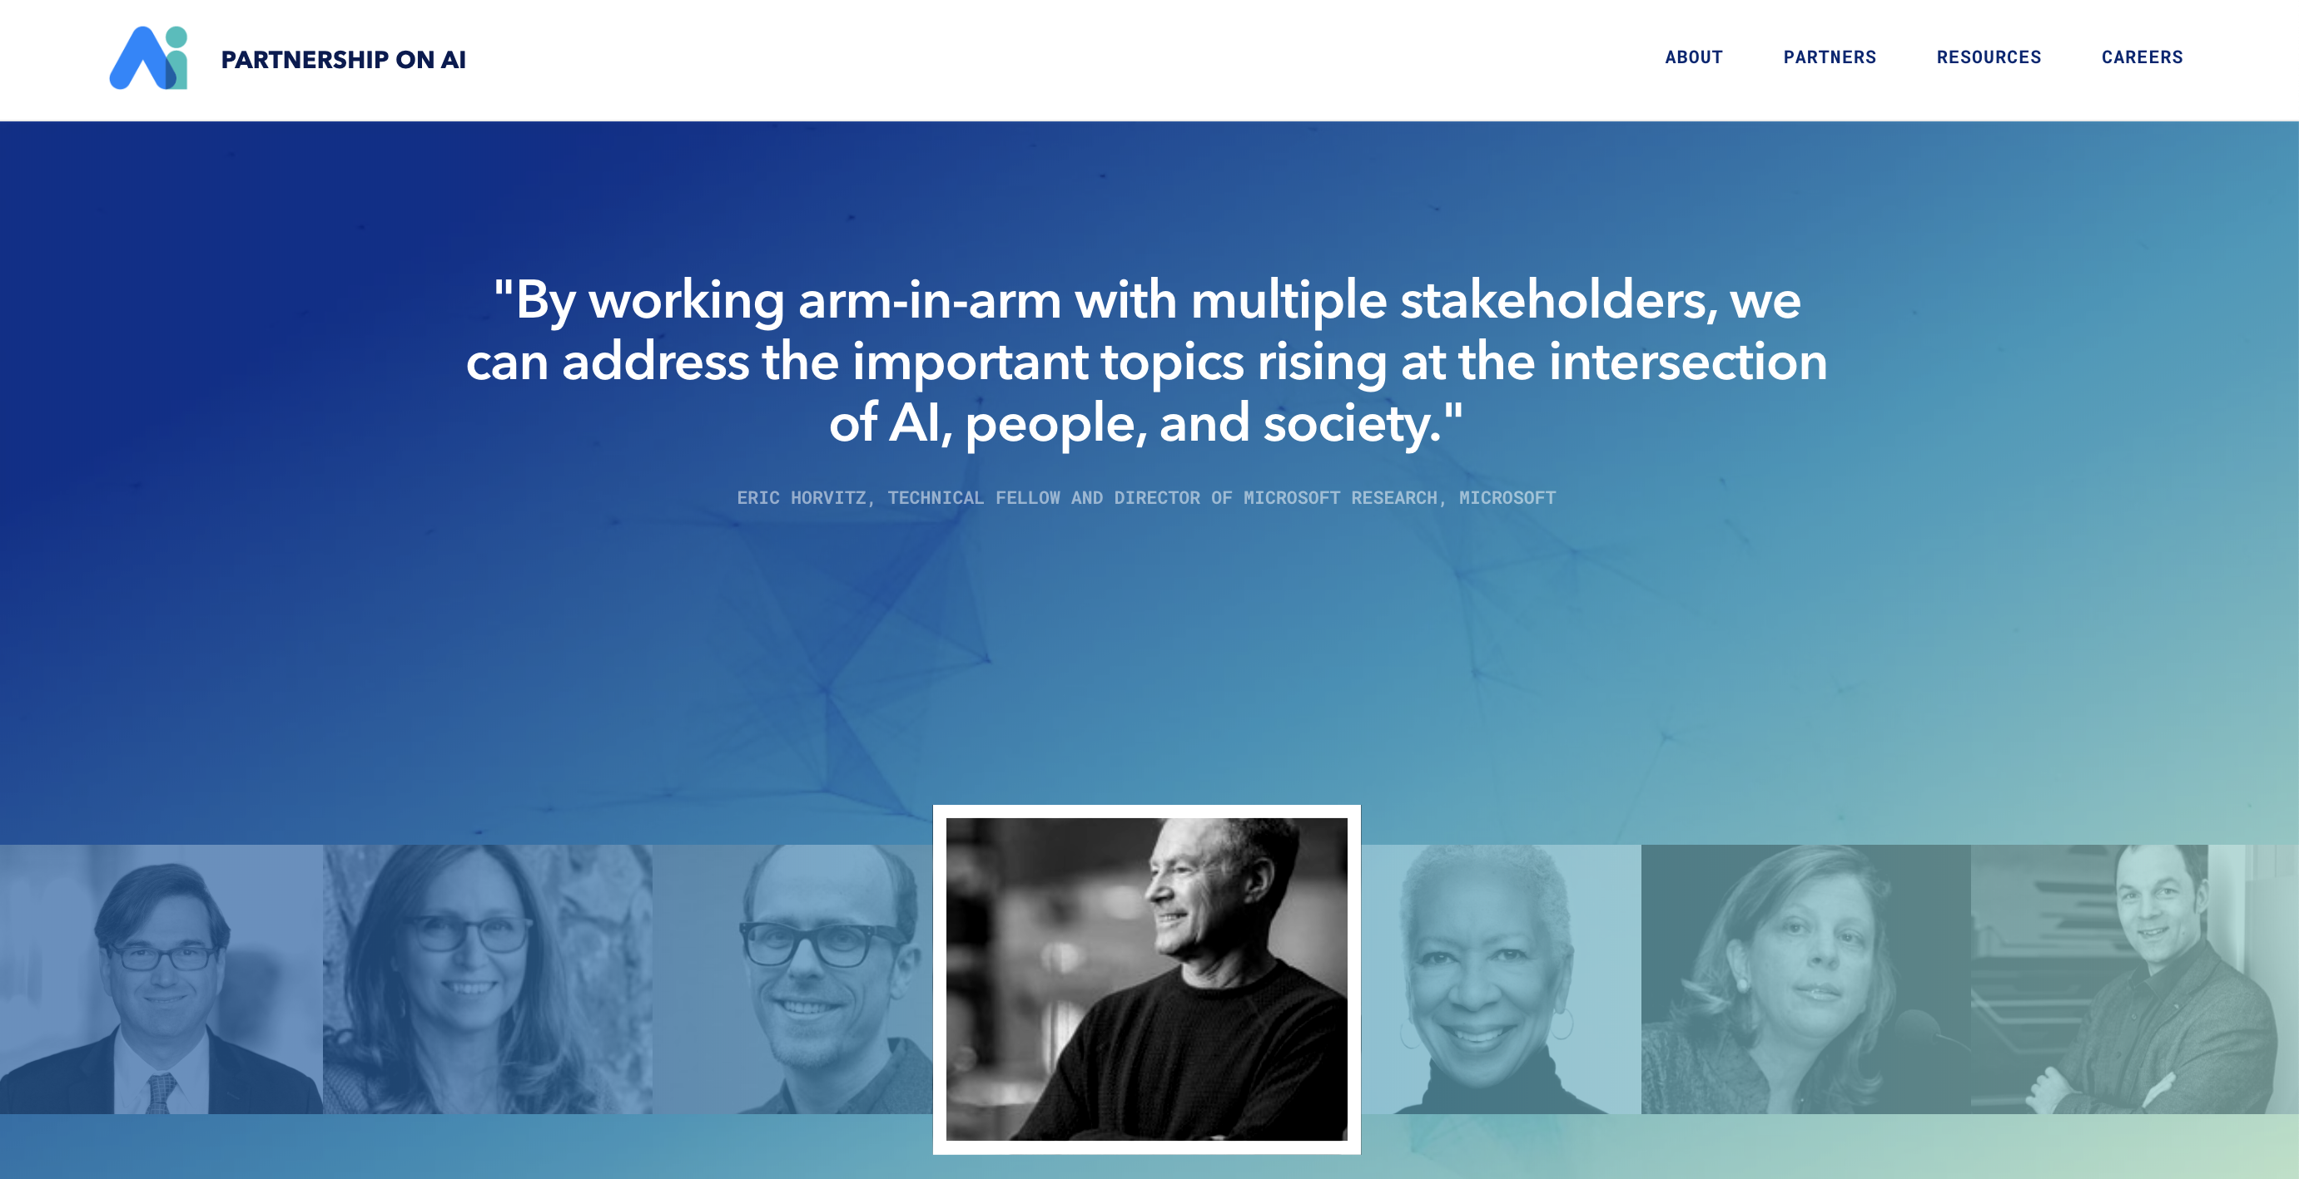

Slide 20
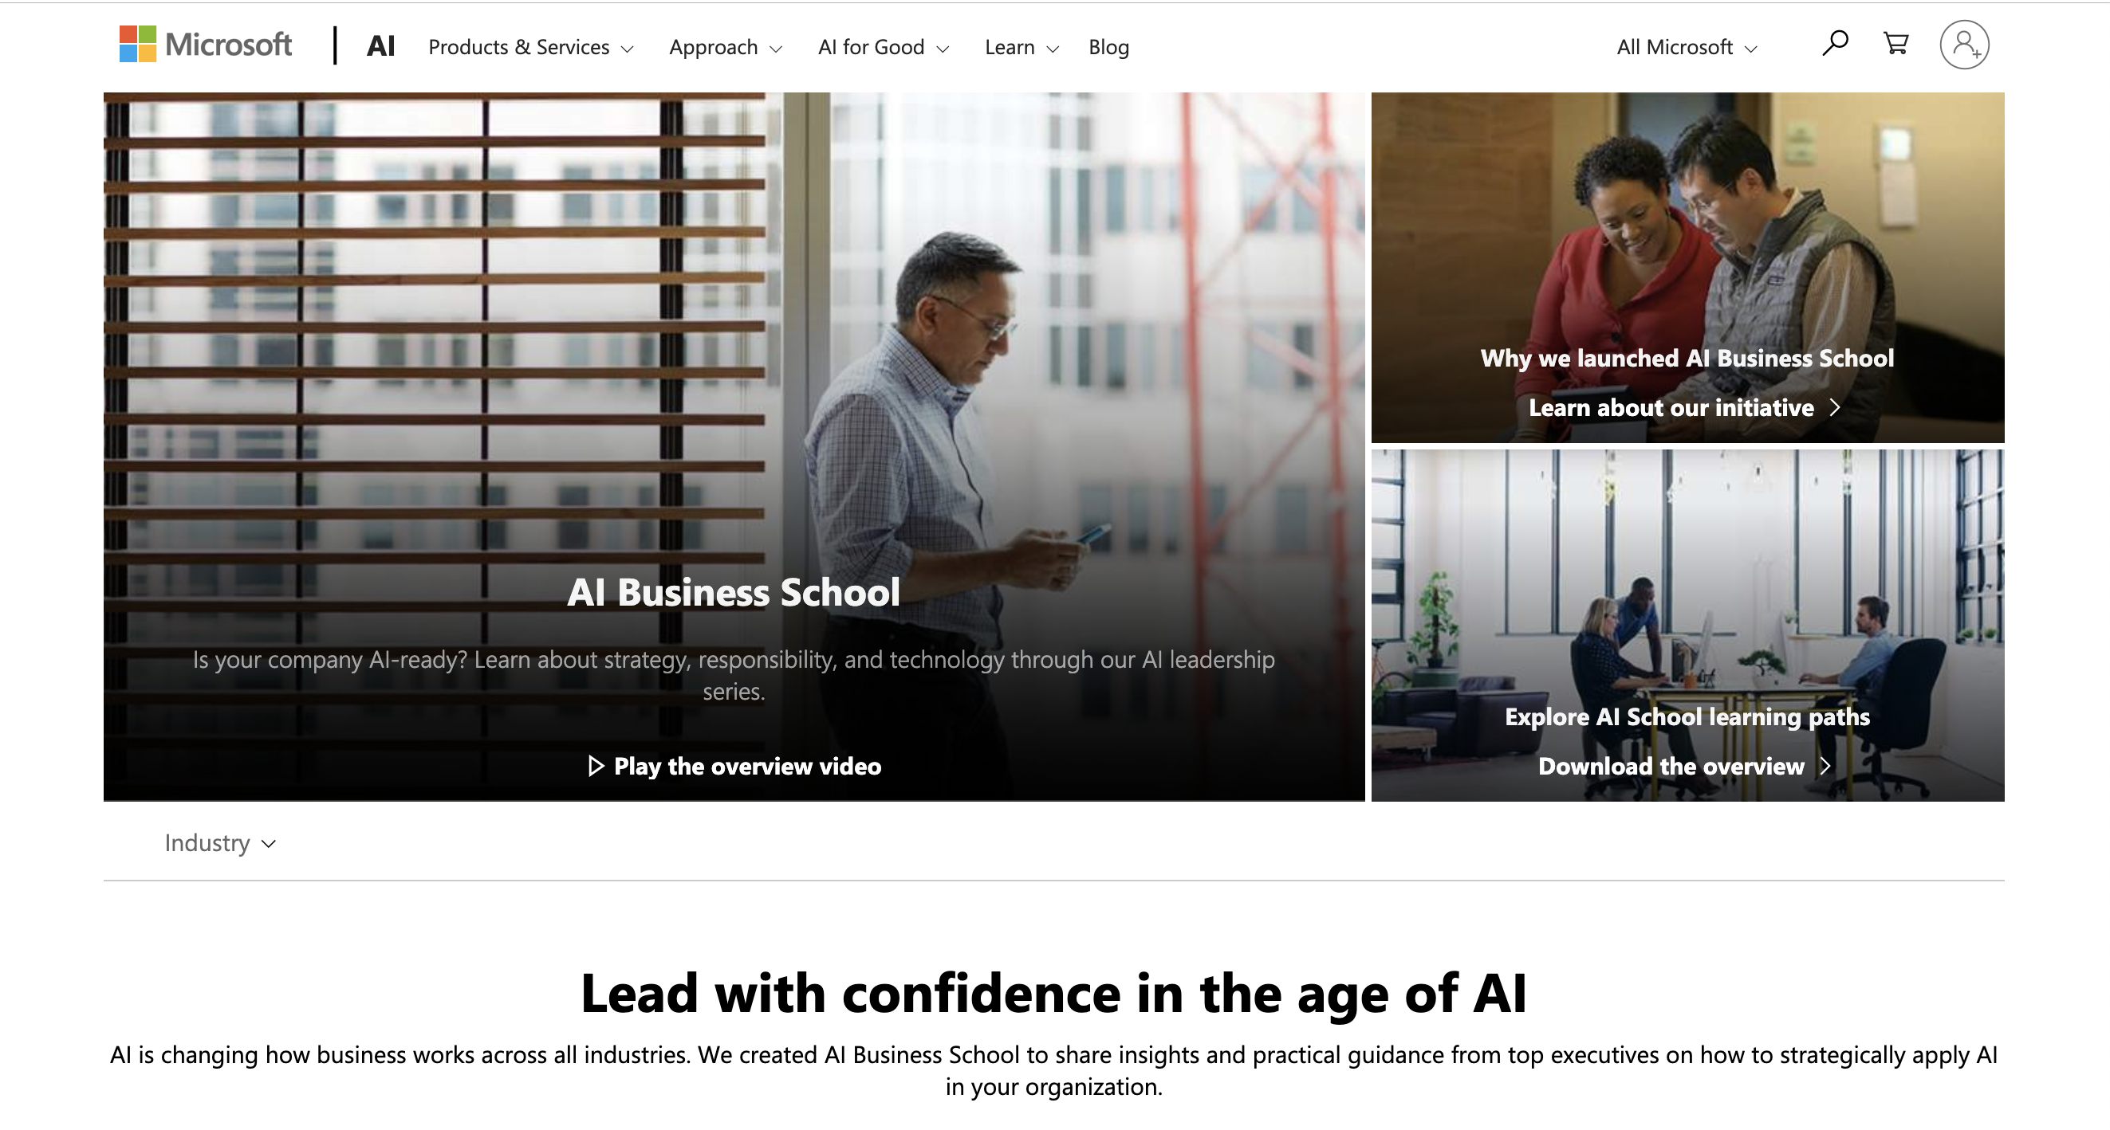
Notes:
And with the launch of the Responsible AI module within the AI Business School (and upcoming launch of V2) we are empowering customers with insights, practices and tools for them to develop and use AI responsibly

Slide 21
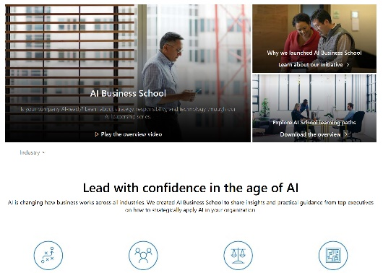
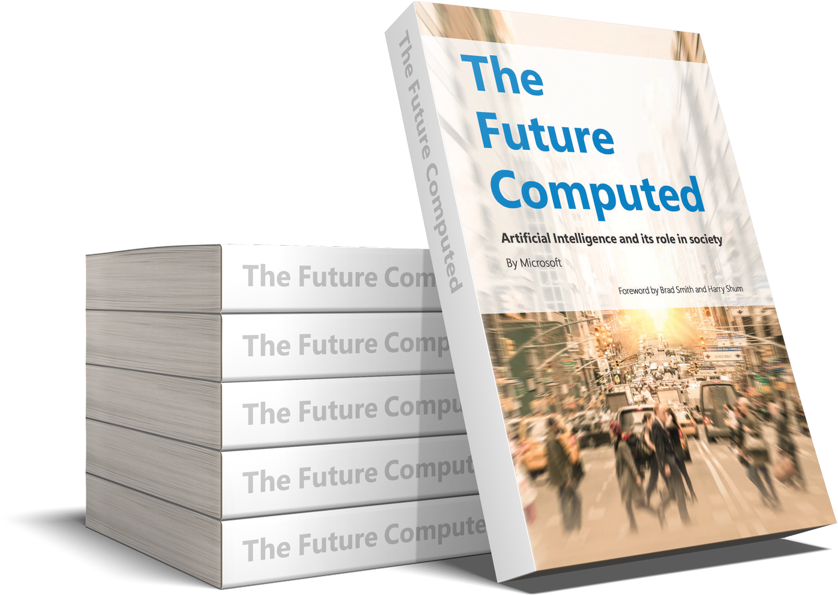


Slide 22
References
Microsoft Responsible AI
https://www.microsoft.com/en-gb/ai/responsible-ai?activetab=pivot1%3aprimaryr6
Fairlearn
https://fairlearn.github.io/
Quick Start
https://fairlearn.github.io/quickstart.html
User Guide
https://fairlearn.github.io/user_guide/index.html
Examples
https://fairlearn.github.io/auto_examples/notebooks/index.html
Reduction
https://arxiv.org/pdf/1803.02453.pdf
Microsoft AI Busines school
https://www.microsoft.com/en-au/ai/ai-business-school
Future Computed
https://blogs.microsoft.com/blog/2018/01/17/future-computed-artificial-intelligence-role-society/

